Slide 1

Department of
Computer Science and Engineering
1151CS204 – WEB PROGRAMMING
Course Category : Program Core
Credits : 3
Slot : S9+L9
Semester : Summer
Academic Year : 2022-2023
Faculty Name : Ms.Minu
School of Computing
Vel Tech Rangarajan Dr. Sagunthala R&D Institute of
Science and Technology

Slide 2
Unit III Server-side programming using PHP and Node JS
Node JS: Introduction- Architecture-Features of Node JS- Installation and setup-Creating web servers with HTTP (Request & Response)-Event Handling-Get and Post Implementations-Database connectivity-case study: online Book Store.
and Project
Management
(SEPM)

Slide 3

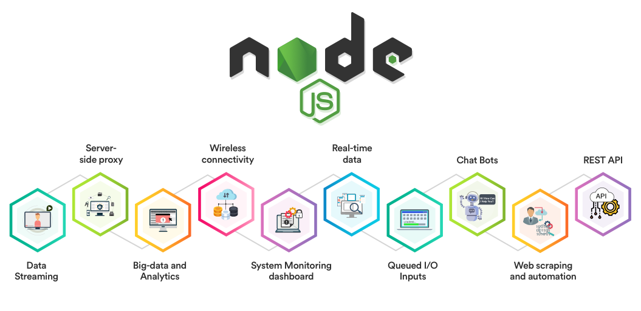
Introduction to Node.js
and Project
Management
(SEPM)

Slide 4
Introduction to Node.js
What is Node Js?
JavaScript can convert a static webpage to an interactive web page
Node js is not a programming language not a framework.
It’s a run time environment where u can run the javascript code.
You can run the javascript code on the stand alone machine.
Node js is cross platform i.e. (you can run on windows, linux os)
With node js you can build stand alone application , mobile application.
Node js can be used as a server side component as it makes use of HTTP module (there are various built in module, as well as module which you can download).
Hence javascript can be used on the browser and can be used on the server there comes the concept of full stack developer.
With express framework you can build web application.
and Project
Management
(SEPM)

Slide 5
Introduction to Node.js
What is Node Js?
Node.js is an open-source, cross-platform runtime environment used for development of server-side web applications.
Node.js applications are written in JavaScript and can be run on a wide variety of operating systems.
Node.js is based on an event-driven architecture and a non-blocking Input/Output API that is designed to optimize an application's throughput and scalability for real-time web applications.
and Project
Management
(SEPM)

Slide 6
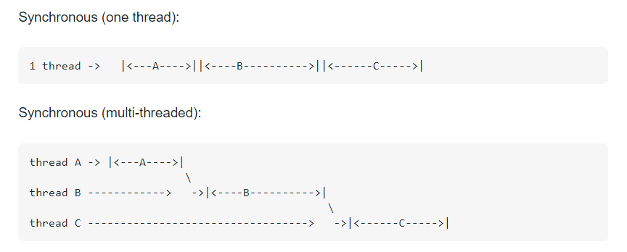
Introduction to Node.js
What is Thread?
Facility to allow multiple activities within a single process
Referred as lightweight process
A thread is a series of executed statements
Each thread has its own program counter, stack and local variables
A thread is a nested sequence of method calls
Its shares memory, files and per-process state
and Project
Management
(SEPM)

Slide 7
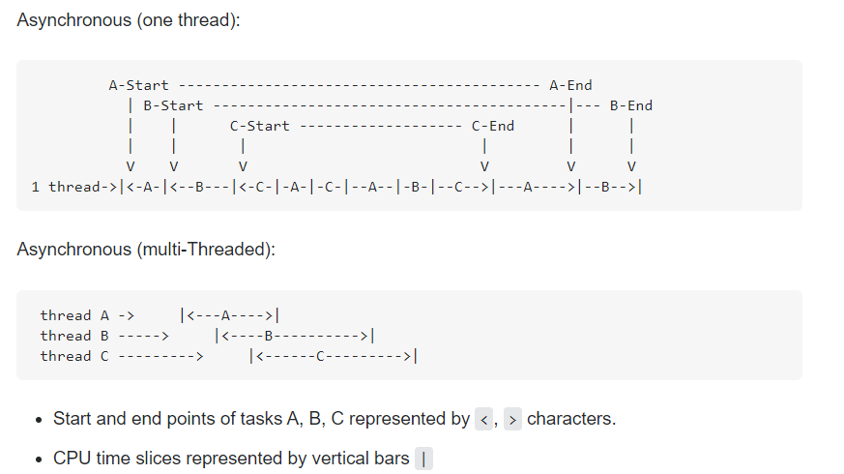
Introduction to Node.js
What is Thread?
and Project
Management
(SEPM)

Slide 8
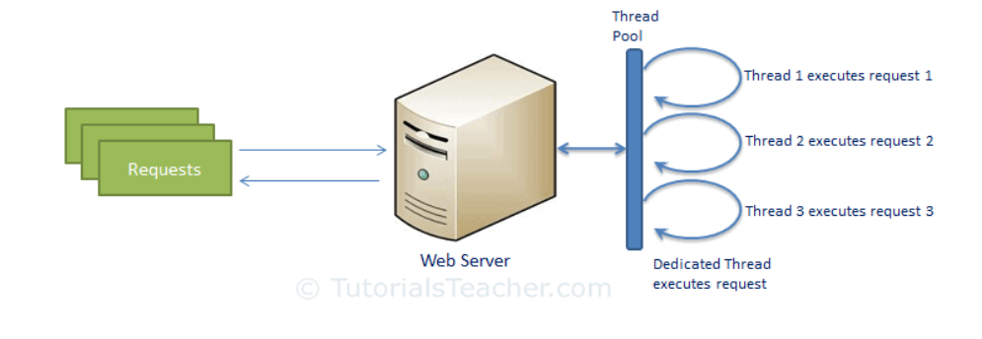
Introduction to Node.js
TRADITIONAL WEB SERVER
and Project
Management
(SEPM)

Slide 9
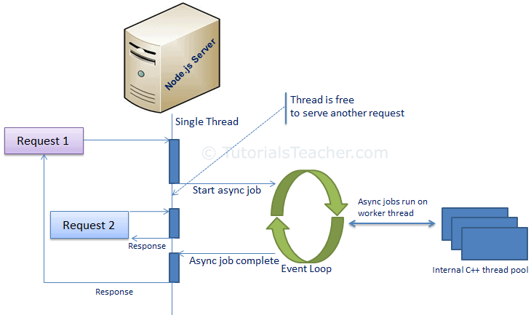
Architecture of Node.js
Node Js Process Model
and Project
Management
(SEPM)

Slide 10
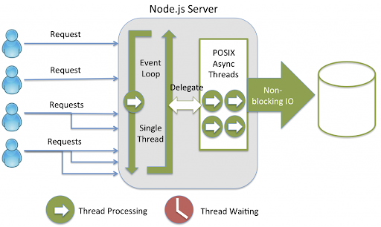
Node.js Architecture
and Project
Management
(SEPM)

Slide 11
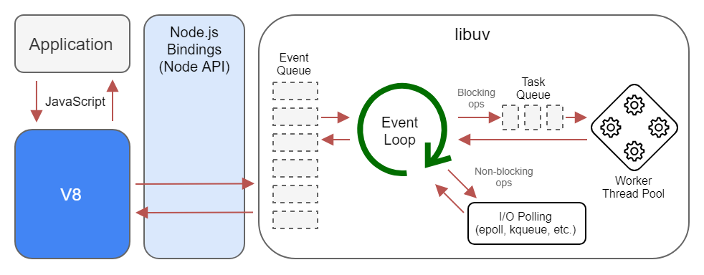
Node.js Architecture
and Project
Management
(SEPM)

Slide 12
Node.js Architecture
Request/Response Model Processing Steps:
Web Server is in infinite Loop and waiting for Client Incoming Requests
Web Server receives those requests.
Web Server pickup one Client Request
Pickup one Thread from Thread pool
Assign this Thread to Client Request
This Thread will take care of reading Client request, processing Client request, performing any Blocking IO Operations (if required) and preparing Response
This Thread sends prepared response back to the Web Server
Web Server in-turn sends this response to the respective Client.
and Project
Management
(SEPM)

Slide 13
Architecture of Node.js
Synchronous
code runs in sequence.
This means that each operation must wait for the previous one to complete before executing.
Asynchronous
Asynchronous I/O is a form of input/output processing that permits other processing to continue before the transmission has finished.
Worker threads
It is a feature within Node.js that is useful for performing heavy JavaScript tasks.
The worker_threads module enables execution of JavaScript codes in parallel, making the entire process quicker and more efficient.
It does this by using an existing pool of ‘workers’ to handle new and incoming tasks.
Worker threads help with CPU-intensive tasks without disturbing the main Node.js thread, offering flexibility and compartmentalization.
and Project
Management
(SEPM)

Slide 14
Architecture of Node.js
Event loop
The event loop is what allows Node. js to perform non-blocking I/O operations — despite the fact that JavaScript is single-threaded .
Event loop is a mechanism that waits for and dispatches events or messages in a program. In Node.js, event loops are the central control flow constructs.
For example, every time a request is about to be handled, it’s put on the event loop and processed as soon as it’s ready to be processed.
Non-blocking I/O
Operations allow a single process to serve multiple requests at the same time. Instead of the process being blocked and waiting for I/O operations to complete, the I/O operations are delegated to the system, so that the process can execute the next piece of code.
and Project
Management
(SEPM)

Slide 15
Features of Node.js
Asynchronous and Event Driven − All APIs of Node.js library are asynchronous, that is, non-blocking. It essentially means a Node.js based server never waits for an API to return data. The server moves to the next API after calling it and a notification mechanism of Events of Node.js helps the server to get a response from the previous API call.
Very Fast − Being built on Google Chrome's V8 JavaScript Engine, Node.js library is very fast in code execution.
Single Threaded but Highly Scalable − Node.js uses a single threaded model with event looping. Event mechanism helps the server to respond in a non-blocking way and makes the server highly scalable as opposed to traditional servers which create limited threads to handle requests. Node.js uses a single threaded program and the same program can provide service to a much larger number of requests than traditional servers like Apache HTTP Server.
No Buffering − Node.js applications never buffer any data. These applications simply output the data in chunks.
and Project
Management
(SEPM)

Slide 16
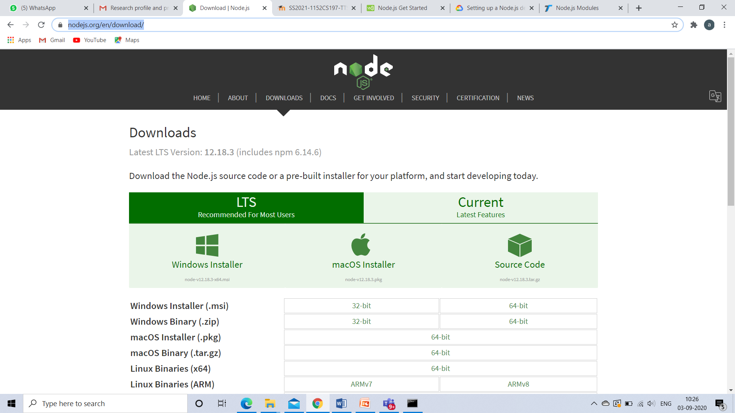
Node.js Installation
https://nodejs.org/en/download/
Choose based on Operating System
and Project
Management
(SEPM)

Slide 17
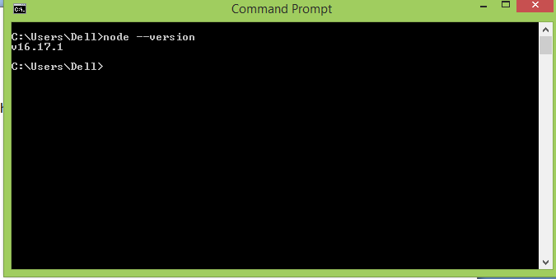
NODE JS CONSOLE BASED EXAMPLE
Open command prompt and type to check version
node –version
and Project
Management
(SEPM)

Slide 18
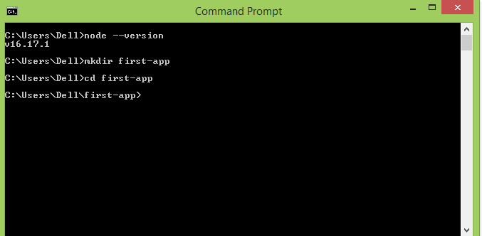
NODE JS CONSOLE BASED EXAMPLE
Create ur own folder : mkdir first-app cd first-app
and Project
Management
(SEPM)

Slide 19
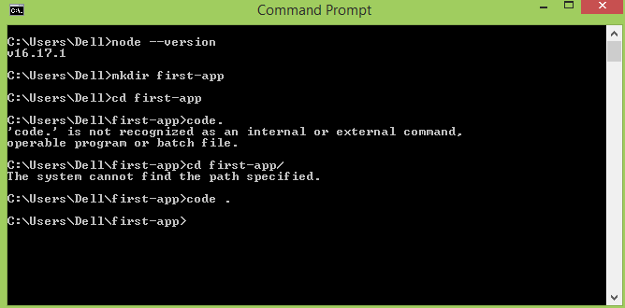
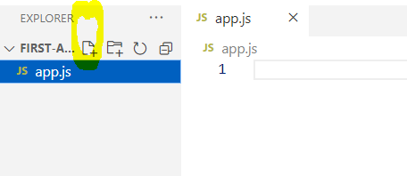
NODE JS CONSOLE BASED EXAMPLE
To open the newly created folder (first-app) in visual studio in cmd prompt u type : code . and press enter
Vs code will get opened -> click d + symbol and create new file(app.js) within the folder (first-app)
and Project
Management
(SEPM)

Slide 20
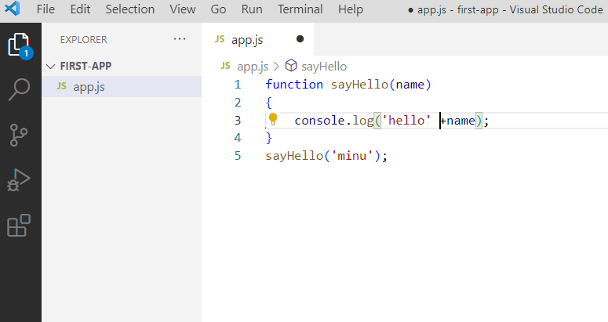
NODE JS CONSOLE BASED EXAMPLE
Next u just type a function in vscode
and Project
Management
(SEPM)

Slide 21
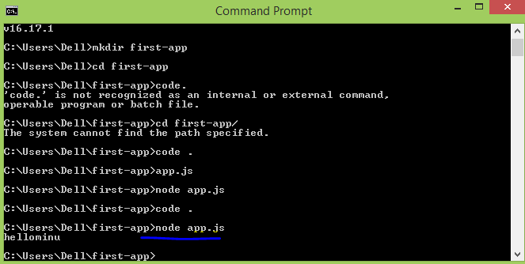
NODE JS CONSOLE BASED EXAMPLE
Now to run the code ->open that command prompt and type
node app.js
and Project
Management
(SEPM)

Slide 22
Creating web servers with HTTP (Request & Response)
1) Node.js HTTP Module
HTTP module can create an HTTP server that listens to server ports and gives a response back to the client.
Use the createServer() method to create an HTTP server:
NODE JS WEB BASED EAMPLE
A node.js web application contains the following three parts:
Import required modules: The "require" directive is used to load a Node.js module.
Create server: You have to establish a server which will listen to client's request similar to Apache HTTP Server.
Read request and return response: Server created in the second step will read HTTP request made by client which can be a browser or console and return the response.
and Project
Management
(SEPM)

Slide 23
Creating web servers with HTTP (Request & Response)
How to create node.js web applications
1. Import required module:
require directive to load http module and store returned HTTP instance into http variable
var http = require("http");
2. Create server:
One.js
var http = require("http");
http.createServer(function (request, response) {
// Send the HTTP header
// HTTP Status: 200 : OK
// Content Type: text/plain
response.writeHead(200, {'Content-Type': 'text/plain'});
// Send the response body as "Hello World"
response.end('Hello World\n');
}).listen(8081);
// Console will print the message
console.log('Server running at http://127.0.0.1:8081/');
and Project
Management
(SEPM)

Slide 24
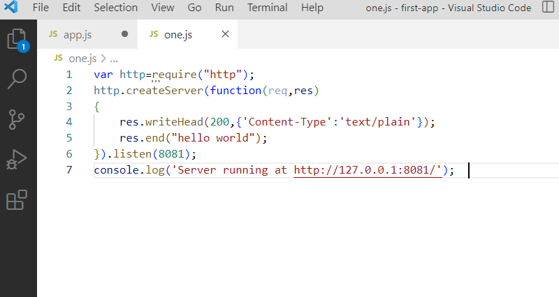
Creating web servers with HTTP (Request & Response)
and Project
Management
(SEPM)

Slide 25
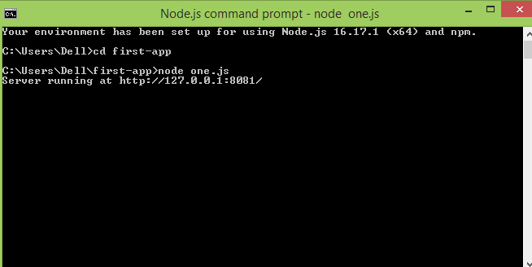
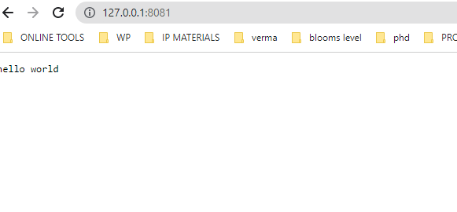
Creating web servers with HTTP (Request & Response)
Go to start menu and click on the Node.js command prompt.
In cmd promt type cd first-app (d folder which u created)
Then run d code : node one.js
In browser u type : 127.0.0.1:8081
and Project
Management
(SEPM)

Slide 26
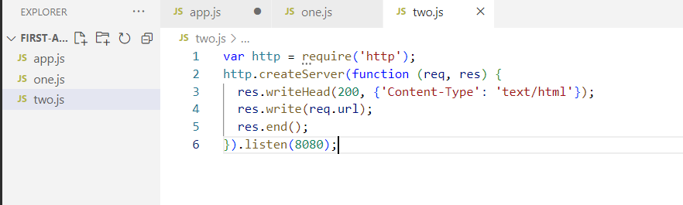
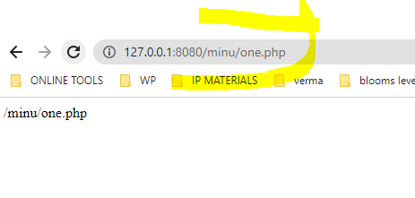
Read the Query String
A property called "url" which holds the part of the url that comes after the domain name.
and Project
Management
(SEPM)

Slide 27
Read the Query String
B) Node.js File System Module
Node.js file system module allows you to work with the file system on your computer.
To include the File System module, use the require() method:
var fs = require('fs');
Common use for the File System module:
Read files
Create files
Update files
Delete files
Rename file
and Project
Management
(SEPM)

Slide 28
Read the Query String
Read Files
The fs.readFile() method is used to read files on your computer.
Assume we have the following HTML file (located in the same folder as Node.js):
demo.html
<html> <body> <h1>My Header</h1> <p>My paragraph.</p> </body> </html>
Create a Node.js file that reads the HTML file, and return the content:
Example
var http = require('http'); var fs = require('fs'); http.createServer(function (req, res) { fs.readFile('demo.html', function(err, data) { res.writeHead(200, {'Content-Type': 'text/html'}); res.write(data); // Contents of the file. return res.end(); }); }).listen(8080);
and Project
Management
(SEPM)

Slide 29
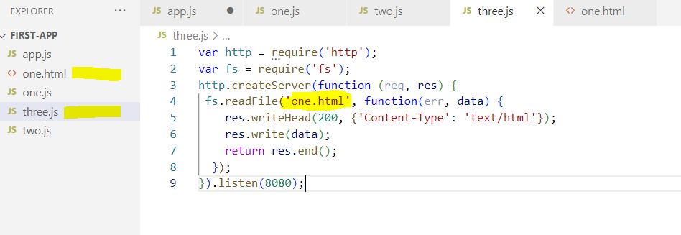
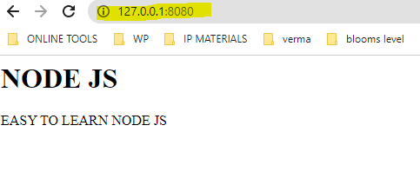
Read the Query String
Read Files
and Project
Management
(SEPM)

Slide 30
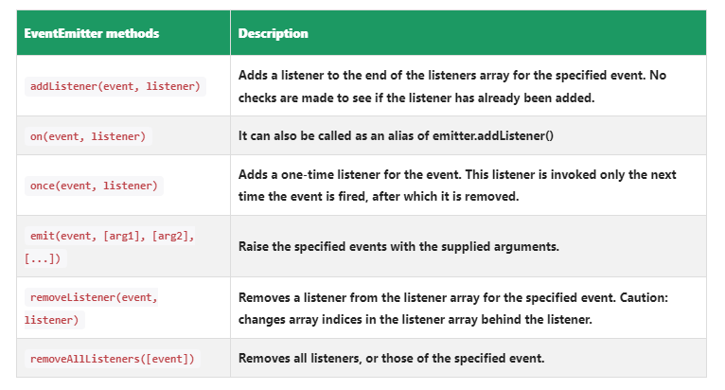
EVENT HANDLING
Every action on a computer is an event. Like when a connection is made or a file is opened.
events module allows us to easily create and handle custom events in Node.js.
This module includes the EventEmitter class, which is used to raise and handle the events.
Some common properties and methods of the events module
and Project
Management
(SEPM)

Slide 31
EVENT HANDLING
EXAMPLE
var events = require('events');
var eventEmitter = new events.EventEmitter();
//Create an event handler:
var myEventHandler = function () {
console.log(My first Node.js event has been triggered'); }
//Assign the eventhandler to an event:
eventEmitter.on('ping', myEventHandler);
// Raising ping event
eventEmitter.emit('ping');
and Project
Management
(SEPM)

Slide 32
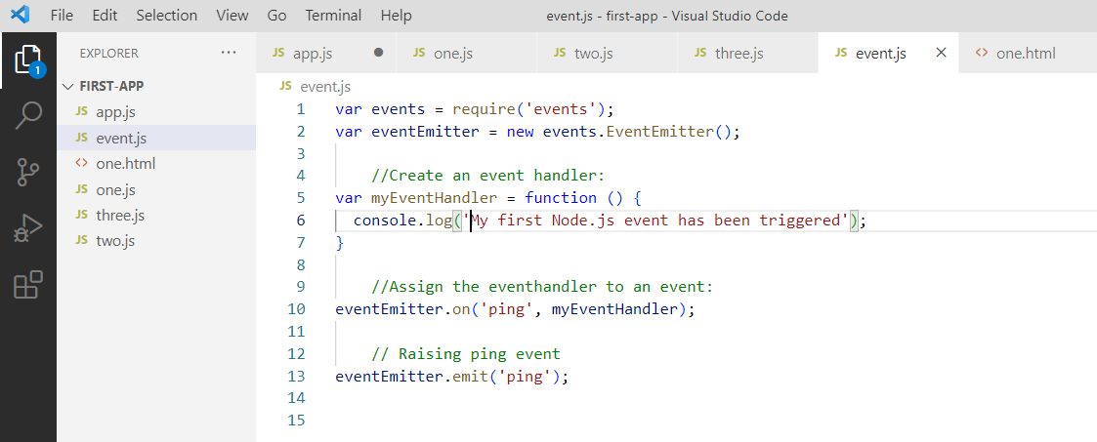
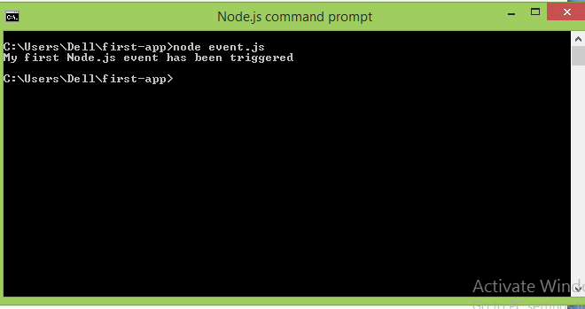
EVENT HANDLING
EXAMPLE
and Project
Management
(SEPM)

Slide 33
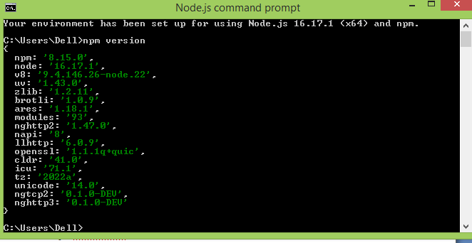
NPM (Node.js Package Manager)
A package in Node.js contains all the files you need for a module.
Modules are JavaScript libraries you can include in your project.
It provides online repositories for node.js packages/modules which are searchable on search.nodejs.org
npm comes bundled with Node.js installables.
You can check the version by opening Node.js command prompt and typing the following command:
npm version
and Project
Management
(SEPM)

Slide 34
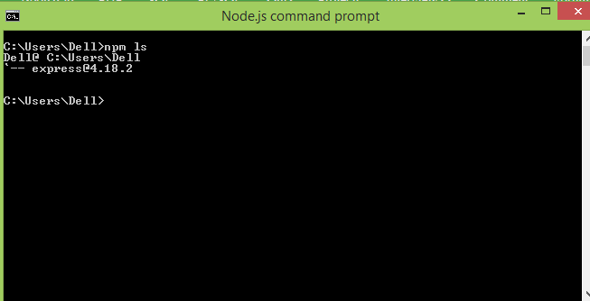
NPM (Node.js Package Manager)
Installing Modules using npm
syntax
npm install <Module Name>
Example
npm install express
npm ls command to list down all the locally installed modules.
and Project
Management
(SEPM)

Slide 35
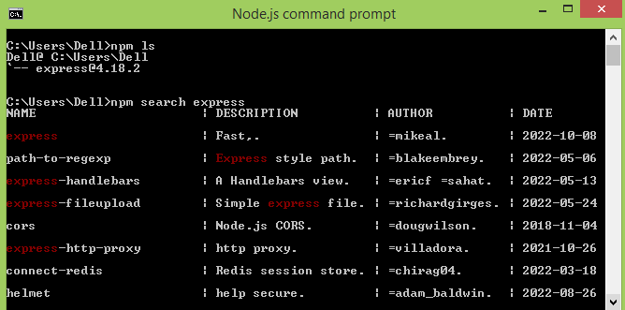
NPM (Node.js Package Manager)
To uninstall a Node.js module, use the following command:
npm uninstall express
Searching a Module
npm search express
and Project
Management
(SEPM)

Slide 36
Handling-Get and Post Implementations
Express.js
Express is a fast, assertive, essential and moderate web framework of Node.js.
You can assume express as a layer built on the top of the Node.js that helps manage a server and routes
It provides features to develop web and mobile applications.
Syntax:
app.get() function routes the HTTP GET Requests to the path which is being specified with the specified callback functions.
app.get( '/', function (req, res) { // -- })
and Project
Management
(SEPM)

Slide 37
Handling-Get and Post Implementations
1) GET IMPLEMENTATION
Gethome.html
<html>
<body>
<form action="http://127.0.0.1:8000/getbasics" method="GET">
First Name: <input type="text" name="first_name"/> <br/>
Last Name: <input type="text" name="last_name"/><br/>
<input type="submit" value="Submit"/>
</form>
</body>
</html>
and Project
Management
(SEPM)

Slide 38
Handling-Get and Post Implementations
GET IMPLEMENTATION
Getbasics.js
var express = require('express');
var app=express();
app.get('/getbasics', function (req, res) { // app.get() function routes the HTTP GET Requests to the path which is being specified with the specified callback functions.
res.send('<p>Username: ' + req.query['first_name']+'</p><p>Lastname: '+req.query['last_name']+'</p>'); // An object containing a property for each query string
parameter in the route.
})
var server = app.listen(8000, function () {
var host = server.address().address // to get the bound address of the server
var port = server.address().port //return the bound address containing the family
name, and port of the server.
console.log(" app listening at http://%s:%s", host, port)
})
and Project
Management
(SEPM)

Slide 39
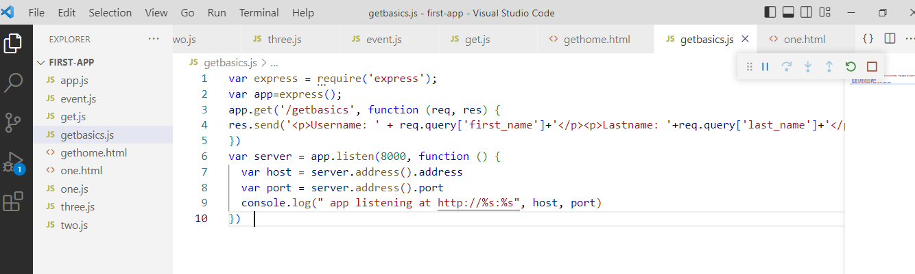
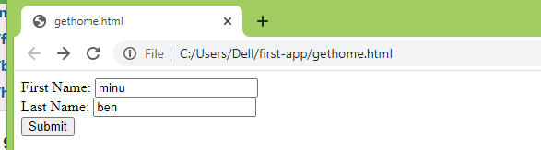
Handling-Get and Post Implementations
GET IMPLEMENTATION
and Project
Management
(SEPM)

Slide 40
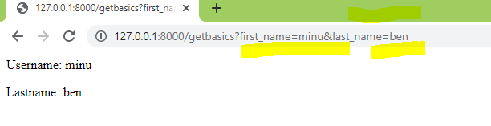
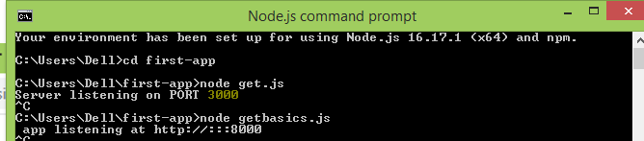
Handling-Get and Post Implementations
GET IMPLEMENTATION
and Project
Management
(SEPM)

Slide 41
Handling-Get and Post Implementations
POST IMPLEMENTATION
Express body-parser is an npm module used to process data sent in an HTTP request body.
urlencoded() : is used to parse the incoming request with urlencoded payloads and is based upon the body-parser.
extended option tells body-parser to use the qs(QUERY STRING) library to parse the URL-encoded data.
app.use() method puts the specified middleware functions at the specified path.
express.static('public')); // To serve static files such as images, CSS files, and JavaScript files,
app.post() function routes the HTTP POST requests to the specified path with the specified callback functions
and Project
Management
(SEPM)

Slide 42
Handling-Get and Post Implementations
POST IMPLEMENTATION
Example:
Posthome.html
<html>
<body>
<form action="http://127.0.0.1:8000/process_post" method="POST">
First Name: <input type="text" name="first_name"> <br>
Last Name: <input type="text" name="last_name">
<input type="submit" value="Submit">
</form>
</body>
</html>
and Project
Management
(SEPM)

Slide 43
Handling-Get and Post Implementations
POST IMPLEMENTATION
Example:
Post basics.js
var express = require('express');
var app = express();
var bodyParser = require('body-parser'); // Create application/x-www-form-urlencoded parser
var urlencodedParser = bodyParser.urlencoded({ extended: false })
app.use(express.static('public')); // To serve static files such as images, CSS files, and JavaScript files
app.get('/posthome.html', function (req, res) {
res.sendFile( __dirname + "/" + "posthome.html" ); // res.sendFile() function basically transfers the file at the given path
})
app.post('/process_post', urlencodedParser, function (req, res) { // app.post() function routes the HTTP POST requests to the specified path with the specified callback functions
and Project
Management
(SEPM)

Slide 44
Handling-Get and Post Implementations
POST IMPLEMENTATION
Example:
Post basics.js
// Prepare output in JSON format
response = {
first_name:req.body.first_name,
last_name:req.body.last_name
};
console.log(response);
res.end(JSON.stringify(response));
})
var server = app.listen(8000, function () {
var host = server.address().address
var port = server.address().port
console.log("Example app listening at http://%s:%s", host, port)
})
and Project
Management
(SEPM)

Slide 45
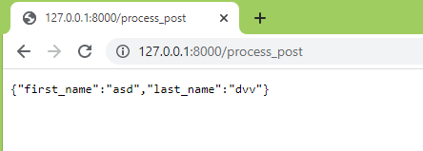
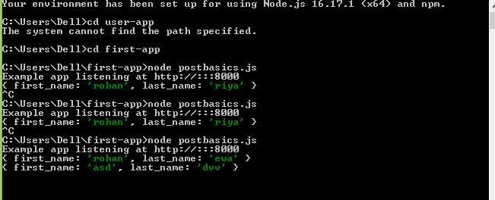
Handling-Get and Post Implementations
POST IMPLEMENTATION
Example:
Post basics.js
and Project
Management
(SEPM)

Slide 46
DATABASE CONNECTIVITY
Node.js can be used in database applications.
To be able to experiment with the examples, you should have MySQL installed on your
computer.
Install MySQL Driver
Now you have downloaded and installed a mysql database driver.
Node.js can use this module to manipulate the MySQL database:
npm install mysql
and Project
Management
(SEPM)

Slide 47
DATABASE CONNECTIVITY
Creating a Database
var mysql = require('mysql');
var con = mysql.createConnection({
host: "localhost",
user: "root",
password: ""
});
con.connect(function(err) {
if (err) throw err;
console.log("Connected!");
con.query("CREATE DATABASE mydb", function (err, result) {
if (err) throw err;
console.log("Database created");
});
});
and Project
Management
(SEPM)

Slide 48
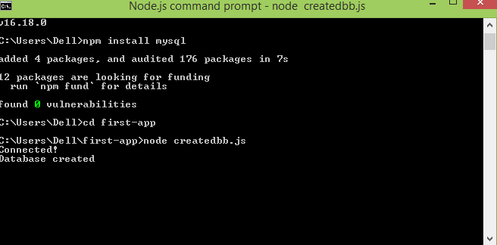
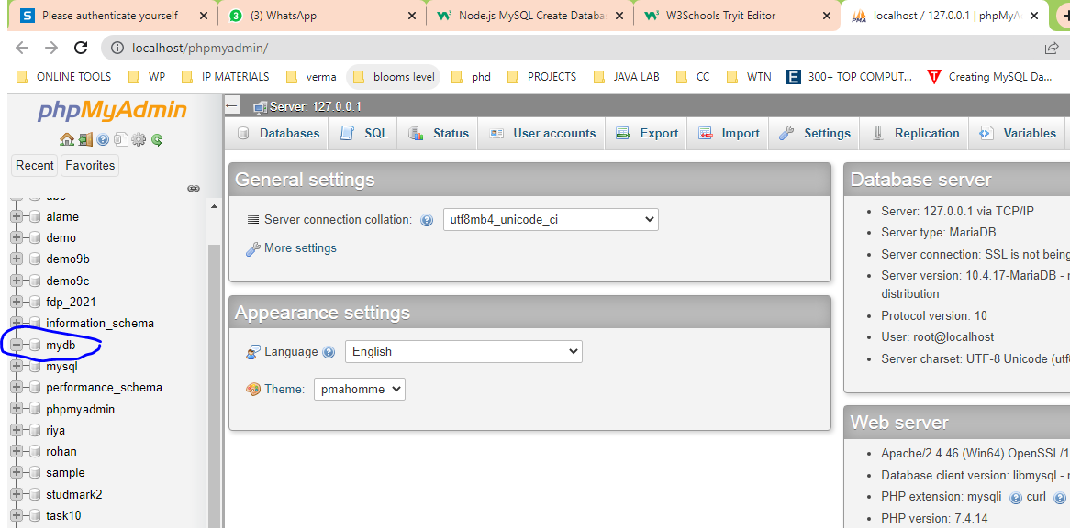
DATABASE CONNECTIVITY
Creating a Database
and Project
Management
(SEPM)

Slide 49
DATABASE CONNECTIVITY
Creating a Table
var mysql = require('mysql');
var con = mysql.createConnection({
host: "localhost",
user: "root",
password: "",
database: "mydb"
});
con.connect(function(err) {
if (err) throw err;
console.log("Connected!");
var sql = "CREATE TABLE student (name VARCHAR(255), address VARCHAR(255))";
con.query(sql, function (err, result) {
if (err) throw err;
console.log("Table created");
});
});
and Project
Management
(SEPM)

Slide 50
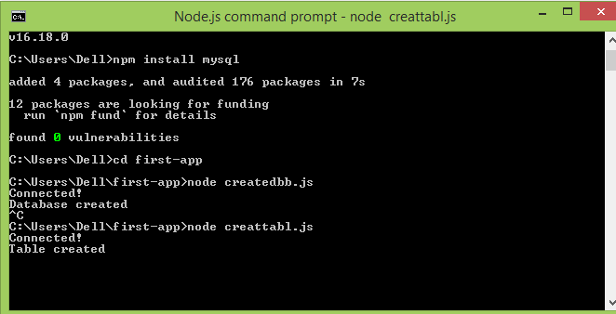
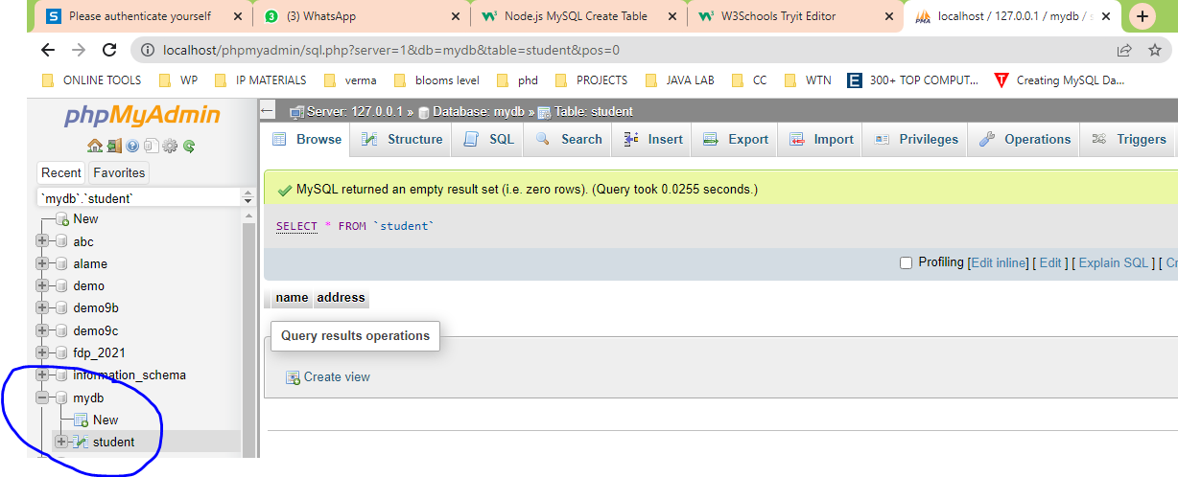
DATABASE CONNECTIVITY
Creating a Table
and Project
Management
(SEPM)

Slide 51
DATABASE CONNECTIVITY
Insert Into Table
var mysql = require('mysql');
var con = mysql.createConnection({
host: "localhost",
user: "root",
password: "",
database: "mydb"
});
con.connect(function(err) {
if (err) throw err;
console.log("Connected!");
var sql = "INSERT INTO student (name, address) VALUES ('Sheryl', 'Chennai')";
con.query(sql, function (err, result) {
if (err) throw err;
console.log("1 record inserted");
});
});
and Project
Management
(SEPM)

Slide 52
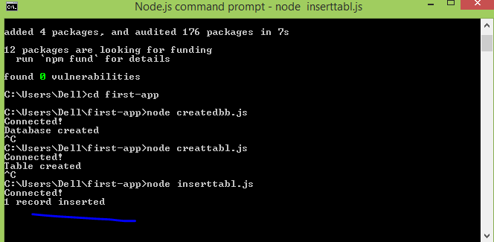
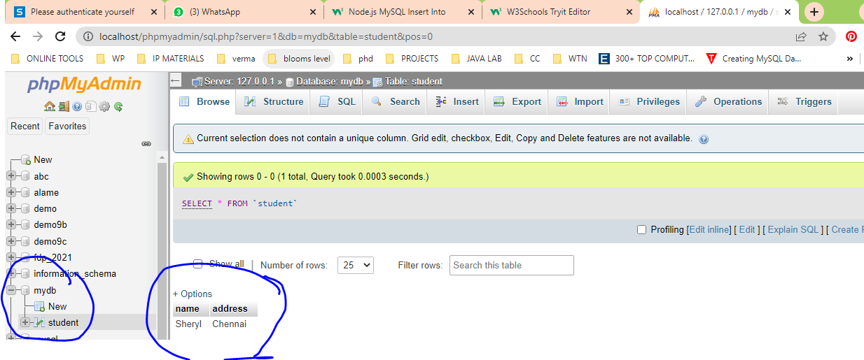
DATABASE CONNECTIVITY
and Project
Management
(SEPM)

Slide 53
Application of Node js
Famous companies that used Node.js for their apps
Paypal
LinkedIn
Yahoo
Mozilla
Netflix
Uber
Groupon
GoDaddy
eBay
and Project
Management
(SEPM)

Slide 54
Thank You
Department of Computer Science and Engineering

